Slide 1
Database
Management System
( II )
Prof. Dr. O.P.Vyas
DAAD Fellow (Germany), AOTS Fellow(Japan)
Indian Institute of Information Technology, Allahabad
Notes:
Ranjana vyas

Slide 2
Database Management System
Storage Management & Backup-Recovery Techniques
  DBMS Storage & Backup-Recovery
  RAID
  Performance Study of PRS
DBMS Query Processing
  Query Parsing
  Query Optimization
Concurrency Control & Transaction Management
  Transaction Concept
  Transaction State
  SQL construct
Recent trends in DBMS
Notes:
Ranjana vyas

Slide 3
Storage Management
Data in a DBMS is stored on storage devices such as disks and tapes
Data must be in memory for the DBMS to operate on it.
The unit for data transfer between disk and main memory is a block;
if a single item on a block is needed, the entire block is transferred.
Reading or writing a disk block is called an I/O (for input/output) operation.
The time to read or write a block varies, depending on the location of the data:
access time = seek time + rotational delay + transfer time
These observations imply that the time taken for database operations is affected significantly by how data is stored on disks.
The time for moving blocks to or from disk usually dominates the time taken for database operations.
To minimize this time, it is necessary to locate

Slide 4
Storage Management
Storage manager is a program module that provides the interface between the low-level data stored in the database and the application programs and queries submitted to the system.
The storage manager is responsible to the following tasks:
  Interaction with the file manager
  Efficient storing, retrieving and updating of data
Issues:
  Storage access
  File organization
  Backup & Recovery
  Performance improvement

Slide 5
Backup and recovery techniques
Backup is based on periodically making copy of databases.
These backup are usually created and stored in multiple secondary backup media.
Backup content is also copied in geographically distinct locations. This strategy is followed to ensure redundancy in storage media.
Copying the same content in distant geographical locations ensures recovery of data in case of flood, earth quake, avalanche and other natural calamities.

Slide 6
Backup and recovery techniques
In order to perform data file media recovery 2 steps are carried out
Copy of data file restored from backup
Update all changes that took after the backup is restored.
Recovery techniques are essentially required as the transaction fails because of
a computer failure,
system crash
erroneous parameter values
programming error,
system or human error.
There are various type of failures, because of which the recovery scheme must be invoked.

Slide 7
Classification of Physical Storage Media
Speed with which data can be accessed
Cost per unit of data
Reliability
  data loss on power failure or system crash
  physical failure of the storage device
Can differentiate storage into:
  volatile storage: loses contents when power is switched off
  non-volatile storage:
    Contents persist even when power is switched off.
    Includes secondary and tertiary storage, as well as battery-backed up main-memory.

Slide 8
Physical Storage Media
Cache – fastest and most costly form of storage; volatile; managed by the computer system hardware
  (Note: “Cache” is pronounced as “cash”)
Main memory:
  fast access (10s to 100s of nanoseconds; 1 nanosecond = 10^{–9} seconds)
  generally too small (or too expensive) to store the entire database
    capacities of up to a few Gigabytes widely used currently
    Capacities have gone up and per-byte costs have decreased steadily and rapidly (roughly factor of 2 every 2 to 3 years)
  Volatile — contents of main memory are usually lost if a power failure or system crash occurs.

Slide 9
Physical Storage Media (Cont.)
Flash memory
  Data survives power failure
  Data can be written at a location only once, but location can be erased and written to again
    Can support only a limited number (10K – 1M) of write/erase cycles.
    Erasing of memory has to be done to an entire bank of memory
  Reads are roughly as fast as main memory
  But writes are slow (few microseconds), erase is slower

Slide 10
Storage Hierarchy (Cont.)
Primary storage: Fastest media but volatile (cache, main memory).
Secondary storage: next level in hierarchy, non-volatile, moderately fast access time
  also called on-line storage
  E.g. flash memory, magnetic disks
Tertiary storage: lowest level in hierarchy, non-volatile, slow access time
  also called off-line storage
  E.g. magnetic tape, optical storage

Slide 11
DBMS performance & Storage
Disks are potential bottlenecks for system performance and storage system reliability.
Even though disk performance has been improving continuously, microprocessor performance has advanced much more rapidly.
The performance of microprocessors has improved at about 50 percent or more per year, but disk access times have improved at a rate of about 10 percent per year and disk transfer rates at a rate of about 20 percent per year.
In addition, since disks contain mechanical elements, they have much higher failure rates than electronic parts of a computer system. If a disk fails, all the data stored on it is lost.

Slide 12
RAID
RAID: Redundant Arrays of Independent Disks
  disk organization techniques that manage a large numbers of disks, providing a view of a single disk of
    high capacity and high speed by using multiple disks in parallel, and
    high reliability by storing data redundantly, so that data can be recovered even if a disk fails
The chance that some disk out of a set of N disks will fail is much higher than the chance that a specific single disk will fail.
  E.g., a system with 100 disks, each with MTTF of 100,000 hours (approx. 11 years), will have a system MTTF of 1000 hours (approx. 41 days)

Slide 13
Improvement of Reliability via Redundancy
Redundancy – store extra information that can be used to rebuild information lost in a disk failure
E.g., Mirroring (or shadowing)
  Duplicate every disk. Logical disk consists of two physical disks.
  Every write is carried out on both disks
    Reads can take place from either disk
  If one disk in a pair fails, data still available in the other
    Data loss would occur only if a disk fails, and its mirror disk also fails before the system is repaired
      Probability of combined event is very small
        Except for dependent failure modes such as fire or building collapse or electrical power surges

Slide 14
Performance study of PRS
The PRS Application CONCERT (Country-wide Network of Computerized Enhanced Reservation and Ticketing) is the world’s largest online reservation application, developed and maintained by CRIS.
PRS caters to 15 to 20 Lakh people on a daily basis and moves over 3,000 trains, covering 1,250 locations with over 4,600 terminals
It uses state of art technology for Performance and maintenance of Database Consistency
Server Blade servers having 64-Bit Itanium 9340 Processor Operating System Open VMS 8.4
Database: In-house CRIS proprietary
Frontend DEC Forms, C and FORTRAN as development tools
Communication Systems CISCO routers using 2Mbps DOT lines\

Slide 15
Data mirroring in PRS
CONCERT architecture is based on the state of the art technology using 3-tier client-server distributed transaction processing paradigm.
Five Regional Computing Systems at
      New Delhi,
      Mumbai,
      Kolkata,
      Chennai and
      Secunderabad
into a National PRS Grid having data mirroring facility for data consistency & performance.

Slide 16
Backup and recovery techniques
Backup is based on periodically making copy of databases.
These backup are usually created and stored in multiple secondary backup media.
Backup content is also copied in geographically distinct locations.
This strategy is followed to ensure redundancy in storage media.
Copying the same content in distant geographical locations ensures recovery of data in case of flood, earth quake, avalanche and their natural calamities.

Slide 17
Query Processing
Parsing and translation
  After a SQL query is submitted , it is parsed and translated.
  A SQL Query is converted into Relational Algebra Expressions
Optimization
  A Query Optimization is performed before actual implementation phase
Evaluation
The Query is evaluated before the producing output

Slide 18

Query Processing
Parsing, or, more formally, syntactic analysis, is the process of analyzing a text, made of a sequence of tokens (for example, words), to determine its grammatical structure with respect to a given (more or less) formal grammar.
Notes:
Ranjana vyas

Slide 19
Query Processing (Cont.)
Alternative ways of evaluating a given query
  Equivalent expressions
  Different algorithms for each operation
Cost difference between a good and a bad way of evaluating a query can be enormous
Need to estimate the cost of operations
  Depends critically on statistical information about relations which the database must maintain
  Need to estimate statistics for intermediate results to compute cost of complex expressions

Slide 20
Transactions
Transaction Management Concept
Transaction State
Concurrent Executions
Serializability
Recoverability
Implementation of Isolation
Transaction Definition in SQL
Testing for Serializability.

Slide 21
Transaction Management Concept
Transaction Management is typical example which highlights the significance of a DBMS.
In case of transferring funds from one bank A/C to other if System failure occurs !
This failure may occur at any stage & the system failures (e.g., power failures, operating system crashes) will result not only as a transaction failure but may be in serious inconsistencies in database.
Money withdrawn from one Account ( and network fails) so not received in the Other A/C. !
Also in concurrent transactions how to ensure the consistency of the database.
Transaction management requires some essential properties to be followed in DBMS

Slide 22
Transaction Processing
A transaction is a unit of program execution that accesses and possibly updates various data items and should follow the given properties;
Atomicity
Implies either all actions within a transaction fully or none.
Consistency
Ensures that each transaction takes the database from one consistent to another
Isolation
Guarantees that events within a transaction must be invisible to other transactions
Durability
Implies that once the transaction is committed its results must be preserved even In the case of failures.
Consistency and isolation of ACID is guaranteed by concurrency control.

Slide 23
ACID Properties
To preserve the integrity of data in transaction processing the database system must ensure:
Atomicity. Either all operations of the transaction are properly reflected in the database or none are.
Consistency. Execution of a transaction in isolation preserves the consistency of the database.
Isolation. Although multiple transactions may execute concurrently, each transaction must be unaware of other concurrently executing transactions. Intermediate transaction results must be hidden from other concurrently executed transactions.
  That is, for every pair of transactions T_{i} and T_{j}, it appears to T_{i} that either T_{j}, finished execution before T_{i} started, or T_{j} started execution after T_{i} finished.
Durability. After a transaction completes successfully, the changes it has made to the database persist, even if there are system failures.

Slide 24
Transaction State
Active – the initial state; the transaction stays in this state while it is executing
Partially committed – after the final statement has been executed.
Failed -- after the discovery that normal execution can no longer proceed.
Aborted – after the transaction has been rolled back and the database restored to its state prior to the start of the transaction. Two options after it has been aborted:
  restart the transaction
    can be done only if no internal logical error
  kill the transaction
Committed – after successful completion.

Slide 25

Transaction State (Cont.)

Slide 26
Maintaining atomicity and durability of ACID property is the task of database recovery.
Transaction is an execution of a series of list of actions.
The actions can include read’s and write’s of database objects.
A schedule is a series of over lapping transactions.

Slide 27
Concurrency control
It is a process of regulating access to same data by multiple transaction operating in same database environment.
Without regulation, database could easily become inconsistent or correct.
Concurrency control deals with the issues involved with allowing multiple people simultaneous access to shared entities.
Several transactions executes concurrently in the database, it is therefore, necessary for the system to control the interaction among them. This control is achieved through one of the mechanism known as concurrency control schemes.

Slide 28
Common types of failures are
Logical errors system errors or system crash
In logical errors, the transaction can no longer continue its normal execution due an error in the logic.
In case of system errors, operating system or procedural rules donot recognize a transaction.
Media failure may also occur if any of instance components such as data file, redo logs & control files are lost.

Slide 29
If a failure occurs database is left in an inconsistent and unusable state. This state is usually referred as crash.
In case of a crash, it is desirable to move the database back to consistent and usable state. This is done by rolling back incomplete transaction and completing committed transactions that were still in memory when the crash occurred.

Slide 30
Transaction Concept
A transaction is a unit of program execution that accesses and possibly updates various data items.
E.g. transaction to transfer $50 from account A to account B:
  1. read(A)
  2. A := A – 50
  3. write(A)
  4. read(B)
  5. B := B + 50
  6. write(B)
Two main issues to deal with:
  Failures of various kinds, such as hardware failures and system crashes
  Concurrent execution of multiple transactions

Slide 31
Example of Fund Transfer
Transaction to transfer $50 from account A to account B:
  1. read(A)
  2. A := A – 50
  3. write(A)
  4. read(B)
  5. B := B + 50
  6. write(B)
Atomicity requirement
  if the transaction fails after step 3 and before step 6, money will be “lost” leading to an inconsistent database state
    Failure could be due to software or hardware
  the system should ensure that updates of a partially executed transaction are not reflected in the database
Durability requirement — once the user has been notified that the transaction has completed (i.e., the transfer of the $50 has taken place), the updates to the database by the transaction must persist even if there are software or hardware failures.

Slide 32
Example of Fund Transfer (Cont.)
Transaction to transfer $50 from account A to account B:
  1. read(A)
  2. A := A – 50
  3. write(A)
  4. read(B)
  5. B := B + 50
  6. write(B)
Consistency requirement in above example:
  the sum of A and B is unchanged by the execution of the transaction
In general, consistency requirements include
    Explicitly specified integrity constraints such as primary keys and foreign keys
    Implicit integrity constraints
      e.g. sum of balances of all accounts, minus sum of loan amounts must equal value of cash-in-hand
  A transaction must see a consistent database.
  During transaction execution the database may be temporarily inconsistent.
  When the transaction completes successfully the database must be consistent
    Erroneous transaction logic can lead to inconsistency

Slide 33
Example of Fund Transfer (Cont.)
Isolation requirement — if between steps 3 and 6, another transaction T2 is allowed to access the partially updated database, it will see an inconsistent database (the sum A + B will be less than it should be).
T1 T2
  1. read(A)
  2. A := A – 50
  3. write(A)
  read(A), read(B), print(A+B)
  4. read(B)
  5. B := B + 50
  6. write(B
Isolation can be ensured trivially by running transactions serially
  that is, one after the other.
However, executing multiple transactions concurrently has significant benefits, as we will see later.

Slide 34
ACID Properties
A transaction is a unit of program execution that accesses and possibly updates various data items.To preserve the integrity of data the database system must ensure:
Atomicity. Either all operations of the transaction are properly reflected in the database or none are.
Consistency. Execution of a transaction in isolation preserves the consistency of the database.
Isolation. Although multiple transactions may execute concurrently, each transaction must be unaware of other concurrently executing transactions. Intermediate transaction results must be hidden from other concurrently executed transactions.
  That is, for every pair of transactions T_{i} and T_{j}, it appears to T_{i} that either T_{j}, finished execution before T_{i} started, or T_{j} started execution after T_{i} finished.
Durability. After a transaction completes successfully, the changes it has made to the database persist, even if there are system failures.

Slide 35
Transaction State
Active – the initial state; the transaction stays in this state while it is executing
Partially committed – after the final statement has been executed.
Failed -- after the discovery that normal execution can no longer proceed.
Aborted – after the transaction has been rolled back and the database restored to its state prior to the start of the transaction. Two options after it has been aborted:
  restart the transaction
    can be done only if no internal logical error
  kill the transaction
Committed – after successful completion.

Slide 36
Transaction State (Cont.)

Slide 37

Implementation of Atomicity and Durability
The recovery-management component of a database system implements the support for atomicity and durability.
E.g. the shadow-database scheme:
  all updates are made on a shadow copy of the database
    db_pointer is made to point to the updated shadow copy after
      the transaction reaches partial commit and
      all updated pages have been flushed to disk.

Slide 38
Implementation of Atomicity and Durability (Cont.)
db_pointer always points to the current consistent copy of the database.
  In case transaction fails, old consistent copy pointed to by db_pointer can be used, and the shadow copy can be deleted.
The shadow-database scheme:
  Assumes that only one transaction is active at a time.
  Assumes disks do not fail
  Useful for text editors, but
    extremely inefficient for large databases (why?)
      Variant called shadow paging reduces copying of data, but is still not practical for large databases
  Does not handle concurrent transactions
Will study better schemes in Chapter 17.

Slide 39
View Expansion
A way to define the meaning of views defined in terms of other views.
Let view v₁ be defined by an expression e₁ that may itself contain uses of view relations.
View expansion of an expression repeats the following replacement step:
repeat
Find any view relation v_{i} in e₁
Replace the view relation v_{i} by the expression defining v_{i}
until no more view relations are present in e₁
As long as the view definitions are not recursive, this loop will terminate
Notes:
Ranjana vyas

Slide 40
Last Week before Mid Sem

Slide 41
Data Engineering: Chronology
Evolutionary step | Business query | Enabling technologies | Product vendors | Characteristics
Data Collection (1960s) | “ What was my total revenue in the last five years” | Computers, tapes, disks | IBM, CDC | Retrospective, static data delivery
Data access (1980s) | “ What were unit sales in New England last March? | Relational Databases, SQL, ODBC | Oracle, Sybase, Informix, IBM,Microsoft | Retrospective dynamic data delivery at record level.
Data Warehousing & Decision support (1990s) | “ What were unit sales in New England last March?Drill down to Boston.” | OLAP, Multi -dimensional databases, DW | Pilot, Comshare, Arbor,Cognos, Microstrategy. | Retrospective, dynamic data delivery at multiple levels.
Data Mining (Emerging ) | “What’s likely to happen to Boston’s unit sales next month? Why ? | Advanced algorithms, massive databases. | Pilot, Lockheed, IBM, SGI, Mineset etc. | Prospective, proactive information delivery.

Slide 42

Data Mining using Large Databases
What is Data Mining?
  Methods for finding interesting structure in large databases
    E.g. patterns, prediction rules, unusual cases
  Focus on efficient, scalable algorithms
  Related to data warehousing, machine learning
Why is Data Mining important?
  Well marketed; now a large industry; pays well
  Handles large databases directly
  Can make data analysis more accessible to end users
    Semi-automation of analysis
    Results can be easier to interpret than e.g. regression models
    Strong focus on decisions and their implementation

Slide 43
Data Mining: A KDD Process
  Data mining: the core of Knowledge Discovery in Databases process.
Knowledge
Pattern Evaluation
Data Mining
Task-relevant Data
Data Warehouse
Selection
Data Cleaning
Data Integration
Transactional Database

Slide 44
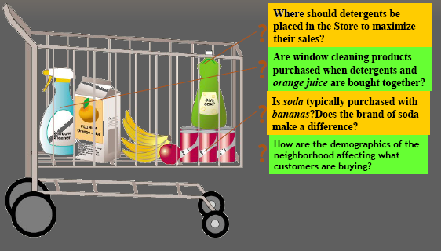
Application Domain
Market Basket Analysis
Various products bought by a customer in a Supermarket were analysed for “interdependency”.
Mining Result is used for, Shelf space organization, formulating discounting-policies and for selective marketing.
Classification
Techniques
Assoc.
Classification

Slide 45
Association Rules
Retail shops are often interested in associations between different items that people buy.
  Someone who buys bread is quite likely also to buy milk
  A person who bought the book Database System Concepts is quite likely also to buy the book Operating System Concepts.
Associations information can be used in several ways.
  E.g. when a customer buys a particular book, an online shop may suggest associated books.
Association rules:
bread ⇒ milk DB-Concepts, OS-Concepts ⇒ Networks
  Left hand side: antecedent, right hand side: consequent
  An association rule must have an associated population; the population consists of a set of instances
    E.g. each transaction (sale) at a shop is an instance, and the set of all transactions is the population

Slide 46
A.R.M.: Road map
Basic concepts of Association Rule Mining
Apriori algorithm
  The model
  Rule strength measures
  Frequent itemset generation
Mining with user-defined inputs
Other A.R.M methods
A.R.M. Implementation websites

Slide 47
What Is Association Mining?
Association rule mining:
  Finding frequent patterns, associations, correlations, or causal structures among sets of items or objects in databases, and other information repositories.
  Proposed by Agrawal et al in 1993.
Applications:
  Basket data analysis, cross-marketing, catalog design, loss-leader analysis, DNA analysis, clustering, classification, etc.
Examples.
  Rule form: “Antecedent → Consequent [support, confidence]”.

Slide 48
Association Rules
Retail shops are often interested in associations between different items that people buy.
  Someone who buys bread is quite likely also to buy milk
  A person who bought the book Database System Concepts is quite likely also to buy the book Operating System Concepts.
Association information can be used in several ways.
  E.g. when a customer buys a particular book, an online shop may suggest associated books.
Association rules:
bread ⇒ milk DB-Concepts, OS-Concepts ⇒ Networks
  Left hand side: antecedent, right hand side: consequent
An association rule is a pattern that states when Antecedent occurs, Consequent occurs with certain probability.

Slide 49
Association Rules (Cont.)
Rules have an associated support, as well as an associated confidence.
Support is a measure of what fraction of the population satisfies both the antecedent and the consequent of the rule.
  E.g. suppose only 0.001 percent of all purchases include milk and screwdrivers. The support for the rule is milk ⇒ screwdrivers is low.
  We usually want rules with a reasonably high support
    Rules with low support are usually not very useful
Confidence is a measure of how often the consequent is true when the antecedent is true.
  E.g. the rule bread ⇒ milk has a confidence of 80 percent if 80 percent of the purchases that include bread also include milk.
  Usually want rules with reasonably large confidence.
    A rule with a low confidence is not meaningful.
    Note that the confidence of bread ⇒ milk may be very
    different from the confidence of milk ⇒ bread, although
    both have the same supports.

Slide 50
Rule strength measures
Support: The rule holds with support sup in T (the transaction data set) if sup% of transactions contain X ∪ Y.
  sup = Pr(X ∪ Y).
Confidence: The rule holds in T with confidence conf if conf% of tranactions that contain X also contain Y.
  conf = Pr(Y | X)
An association rule is a pattern that states when X occurs, Y occurs with certain probability.

Slide 51
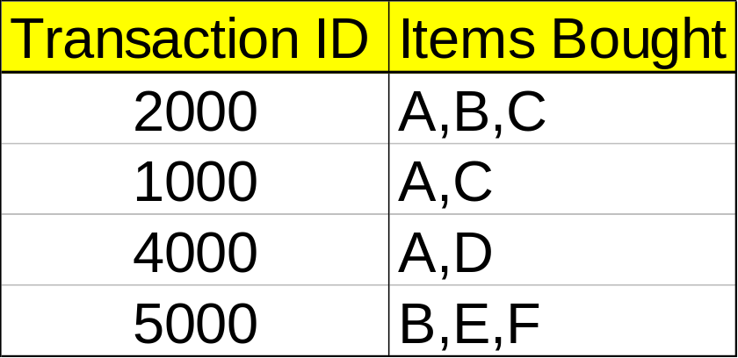
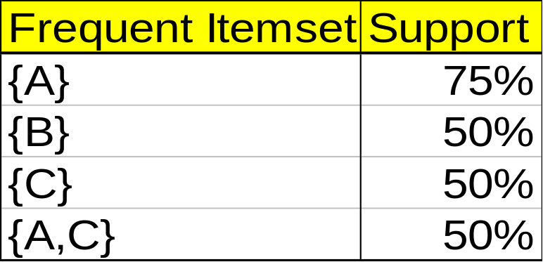
Mining Association Rules—An Example
Let us take the
Min. support 50%
Min. confidence 50%
For rule A ⇒ C :
  support = support({A C}) = 50%
  confidence = support({A C})/support({A}) = 66.6%
  A ⇒ C (50%, 66.6%)
  C ⇒ A (50%, 100%)
  The Apriori principle:
  Any subset of a frequent itemset must be frequent

Slide 52
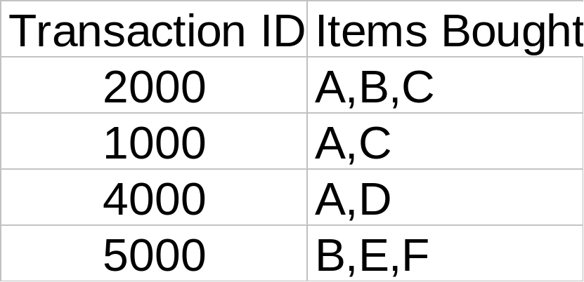
Rule Measures: Support and Confidence
Customer
buys both
Customer
buys diaper
Find all the rules X & Y ⇒ Z with minimum confidence and support
  support, s, probability that a transaction contains {X  Y  Z}
  confidence, c, conditional probability that a transaction having {X  Y} also contains Z
Customer
buys beer
-- Let minimum support 50%, and minimum confidence 50%, we have
  A ⇒ C (50%, 66.6%)
  C ⇒ A (50%, 100%)

Slide 53
Association Rule Mining : Mining Frequent Itemsets
ARM is a two step process ;
1. Find the frequent itemsets: the sets of items that have minimum support
  A subset of a frequent itemset must also be a frequent itemset
    i.e., if {AB} is a frequent itemset, both {A} and {B} should be a frequent itemset
  Iteratively find frequent itemsets with cardinality from 1 to k (k- itemset)
2. Use the frequent itemsets to generate association rules. ( as these rules will satisfy minimum support and minimum confidence)

Slide 54
The Apriori Algorithm
Join Step: C_{k} is generated by joining L_{k-1}with itself
Prune Step: Any (k-1)-itemset that is not frequent cannot be a subset of a frequent k-itemset
Pseudo-code:
    C_{k}: Candidate itemset of size k
    L_{k} : frequent itemset of size k
    L₁ = {frequent items};
    for (k = 1; L_{k} !=∅; k++) do begin
    C_{k+1} = candidates generated from L_{k};
    for each transaction t in database do
      increment the count of all candidates in C_{k+1} that are contained in t
    L_{k+1} = candidates in C_{k+1} with min_support
    end
    return ∪_{k} L_{k};

Slide 55








The Apriori Algorithm — Example
Database D
L₁
C₁
Scan D
C₂
C₂
L₂
Scan D
C₃
Scan D
L₃

Slide 56
Generating rules from frequent itemsets
Frequent itemsets ≠ association rules
One more step is needed to generate association rules
For each frequent itemset X,
For each proper nonempty subset A of X,
  Let B = X - A
  A → B is an association rule if
    Confidence(A → B) ≥ minconf,
    support(A → B) = support(A∪B) = support(X)
    confidence(A → B) = support(A ∪ B) / support(A)

Slide 57
Generating association rules..
Once the frequent itemsets from transactions in a database D have been found, it is straightforward to generate strong association rules from them ( where strong association rules satisfy both minimum support and minimum confidence).
To recap, in order to obtain A → B, we need to have support(A ∪ B) and support(A)
All the required information for confidence computation has already been recorded in itemset generation. No need to see the data T any more.
This step is not as time-consuming as frequent itemsets generation.

Slide 58
Goal and key features
Goal: Find all rules that satisfy the user-specified minimum support (minsup) and minimum confidence (minconf).
Key Features
  Completeness: find all rules.
  No target item(s) on the right-hand-side
  Mining with data on hard disk (not in memory)

Slide 59
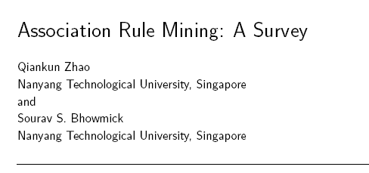
Many ARM algorithms
There are a large number of them!!
They use different strategies and data structures.
Their resulting sets of rules are all the same.
  Given a transaction data set T, and a minimum support and a minimum confident, the set of association rules existing in T is uniquely determined.
Any algorithm should find the same set of rules although their computational efficiencies and memory requirements may be different. We study only one: the Apriori Algorithm

Slide 60
On Apriori Algorithm
Seems to be very expensive
Level-wise search
K = the size of the largest itemset
It makes at most K passes over data
In practice, K is bounded (10).
The algorithm is very fast. Under some conditions, all rules can be found in linear time.
Scale up to large data sets
Clearly the space of all association rules is exponential, O(2^{m}), where m is the number of items in I.
The mining exploits sparseness of data, and high minimum support and high minimum confidence values.
Still, it always produces a huge number of rules, thousands, tens of thousands, millions, ...

Slide 61
UCI KDD Archive
http://kdd.ics.uci.edu
This is an online repository of large data sets which encompasses a wide variety of data types, analysis tasks, and application areas.
The primary role of this repository is to enable researchers in knowledge discovery and data mining to scale existing and future data analysis algorithms to very large and complex data sets.
. The archive is intended to serve as a permanent repository of publicly-accessible data sets for research in KDD and data mining. It complements the original UCI Machine Learning Archive , which typically focuses on smaller classification-oriented data sets.

